Slide 1
Electronic Sleep Inducer

Slide 2
Problem
Millions suffer from insomnia and irregular sleep cycles.
Current solutions (pills, wearables, therapy) are often expensive, addictive, or inconvenient.
There is a need for a safe, technology-driven alternative.

Slide 3
Solution: Electronic Sleep Inducer
FPGA-controlled device that regulates breathing patterns using LED guidance.
MAX30102 sensor tracks bio-signals for adaptive control.
Non-invasive, drug-free, and easy-to-use sleep aid.

Slide 4
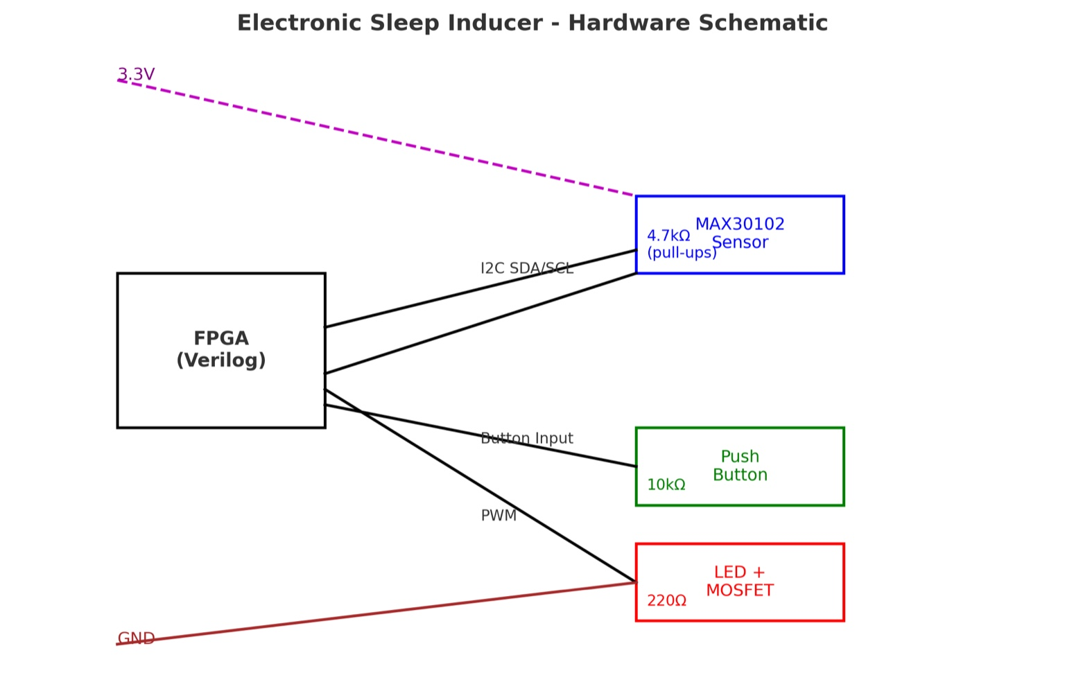
Hardware Schematic

Slide 5
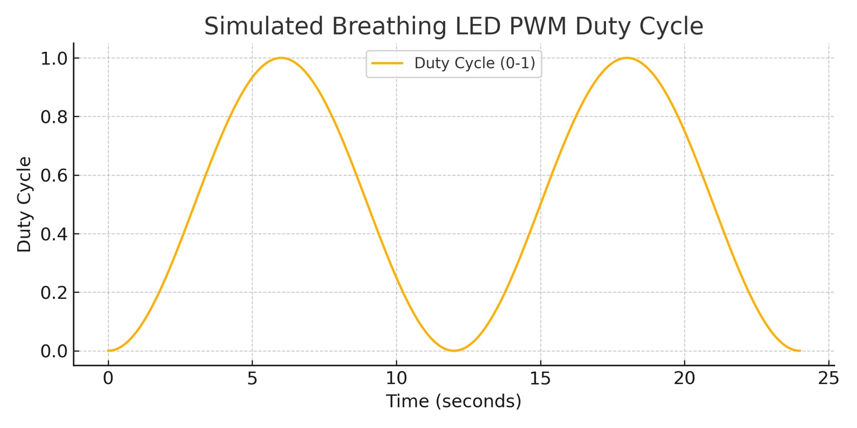
Working Principle
LED brightness modulated with PWM to simulate natural breathing cycles.

Slide 6
Market Opportunity
Global Sleep Aid Market > $80B by 2030.
Increasing demand for non-invasive, tech-driven solutions.
Target segments: Students, working professionals, and health-conscious consumers.

Slide 7
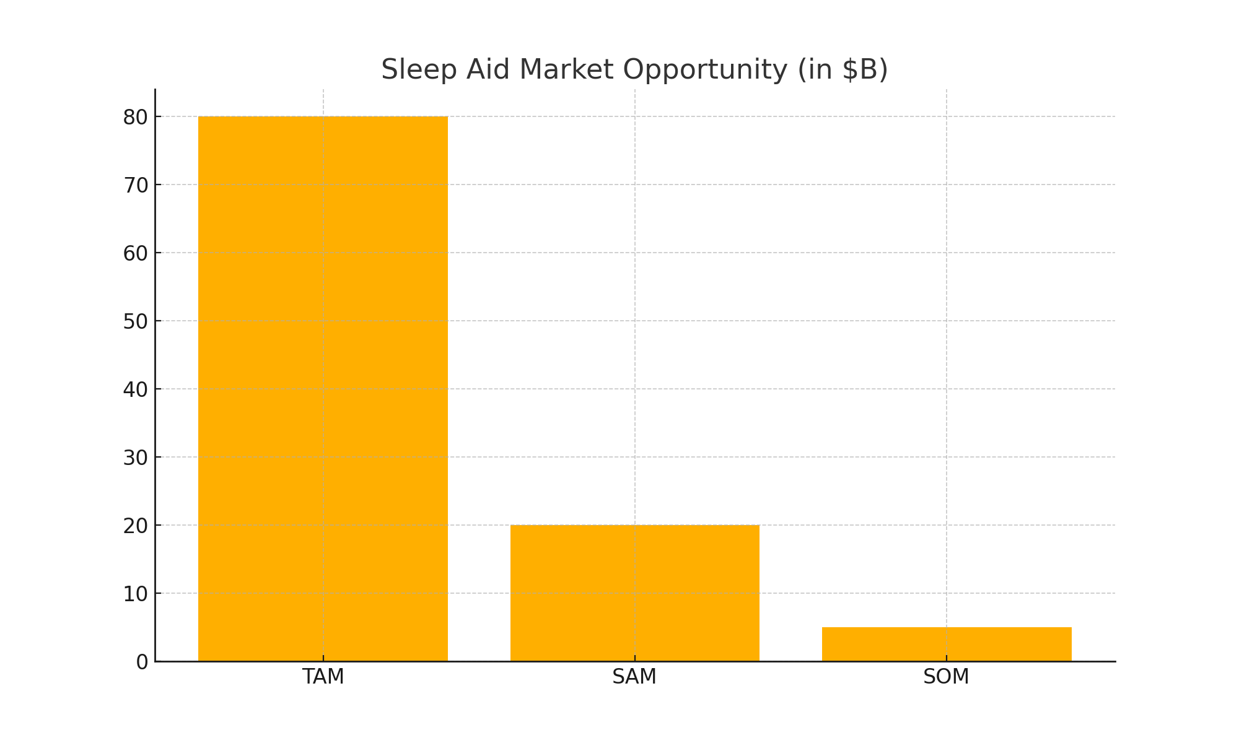
Market Opportunity

Slide 8
Business Model
Direct-to-Consumer device sales.
Subscription model for advanced biofeedback & sleep tracking app.
Potential partnerships with wellness clinics and corporates.
Subscription for app-based sleep analytics.

Slide 9
Traction / Validation
Prototype tested successfully with initial users.
Positive feedback on usability & effectiveness.
Ready for pilot launch with student and corporate groups.

Slide 10
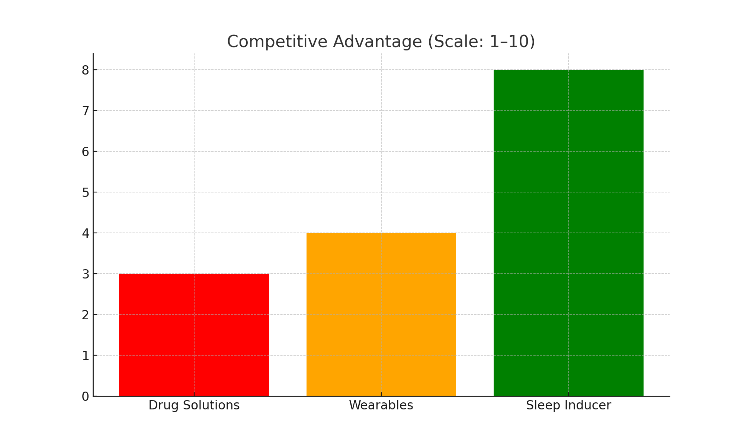
Competitive Landscape

Slide 11
Go-to-Market Strategy
Phase 1: Target students & professionals via online D2C.
Phase 2: Partnerships with wellness clinics & corporates.
Phase 3: Global expansion with mobile app integration.

Slide 12
Competitive Advantage
Drug-free, safe, and affordable.
FPGA-based flexibility for adaptive algorithms.
Integration with biosensors (MAX30102) for personalized sleep patterns.
Compact and portable design.

Slide 13
Financials & Roadmap
Prototype developed and validated.
Seed funding required: ₹1.5 Cr (~$180K).
Roadmap:
- Year 1: Pilot launch, clinical validation.
- Year 2: D2C rollout + Mobile App.
- Year 3: Scale manufacturing & partnerships.

Slide 14
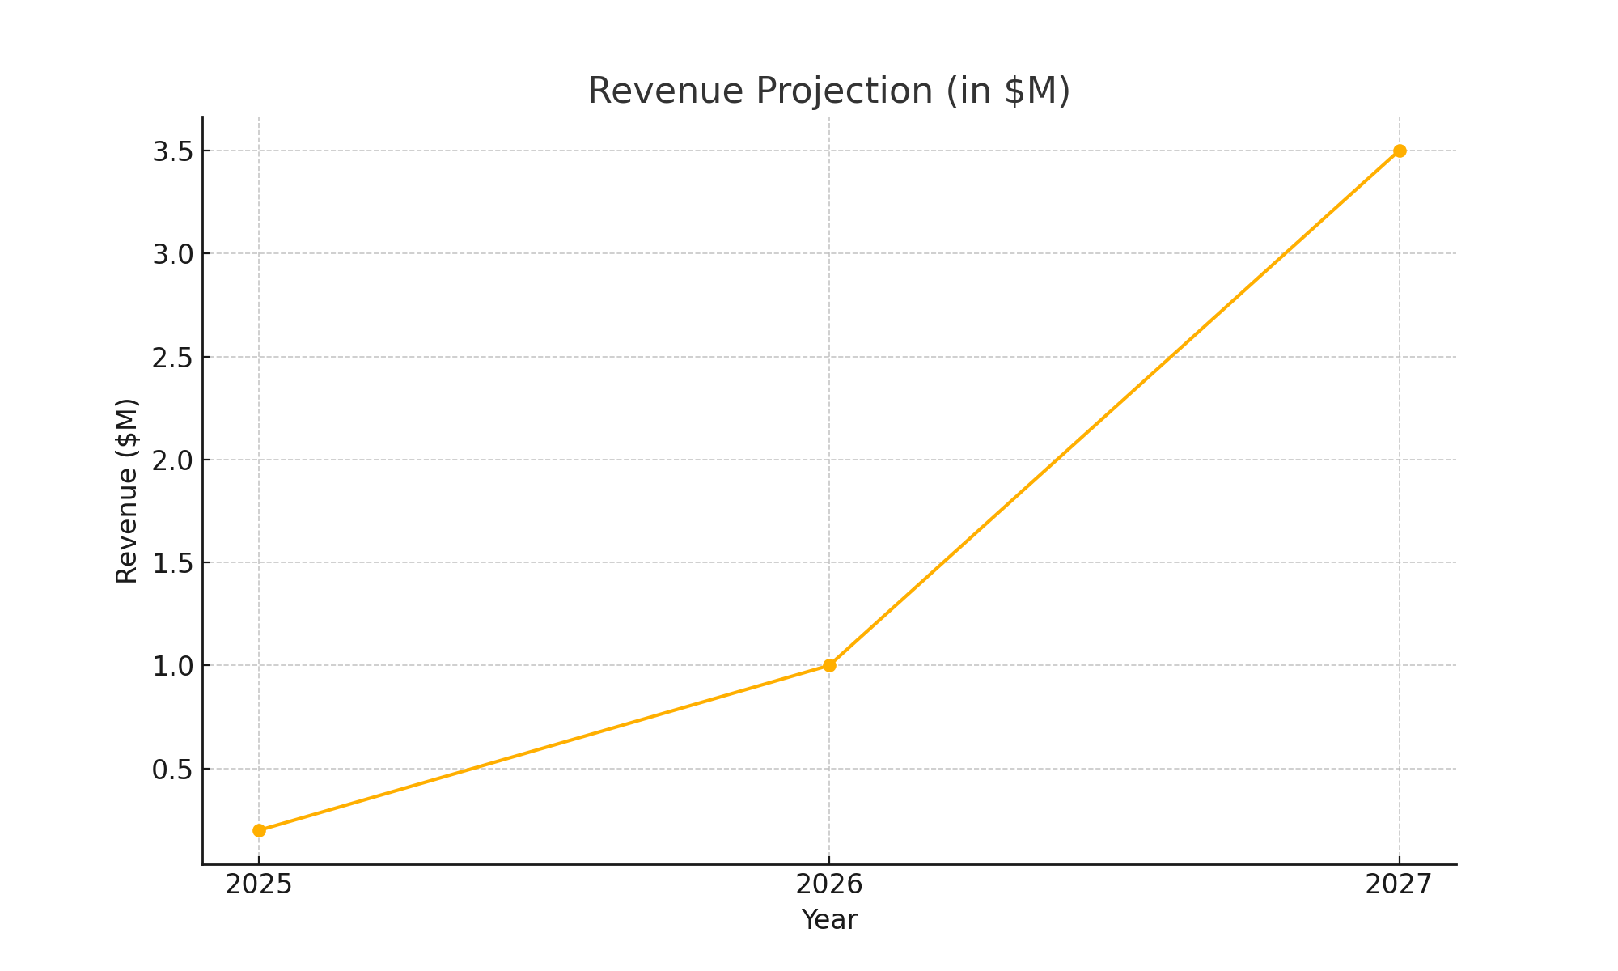
Financials / Projections

Slide 15
Our Team
Founder: Hardware design & FPGA specialist.
Co-founder: Biomedical engineer.
Advisors: Sleep research experts & IIM mentors.

Slide 16
The Ask
Funding Required: ₹1.5 Cr (~$180K).
Use of Funds: Product development, manufacturing, marketing, clinical validation.
Looking for strategic investors with expertise in health-tech and consumer electronics.

Slide 17
Closing Note
"Helping the world sleep better with technology."
Thank you!

